Slide 1



Slide 2



To listen for specific information
To learn to make predictions with the sentence patterns:
-- Will people use money in 100 years?
-- No, they won’t. Everything will be free.
-- Will people live to be 200 years old?
-- Yes, they will.
To learn some new words and expressions

Slide 3

Unit 7

Slide 4



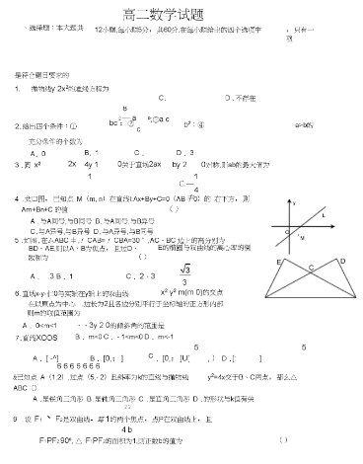
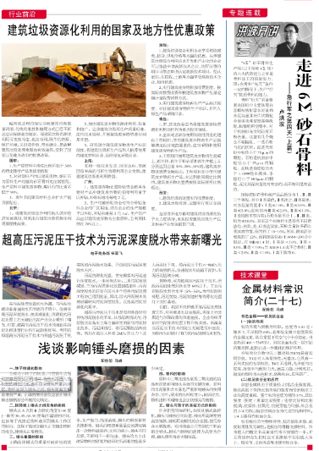
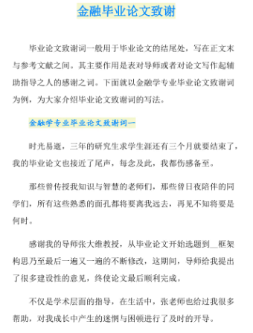
paper n.
①纸；纸张 (不可数名词)
表达数量时常借助于piece
a piece of paper 一张纸
two pieces of paper 两张纸
②试卷；报纸；论文(可数名词)
an exam paper 考卷

Slide 5
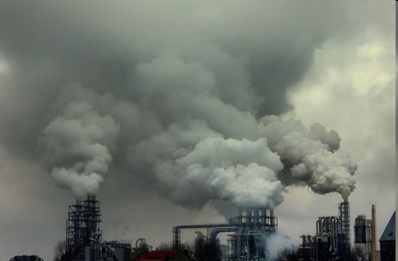
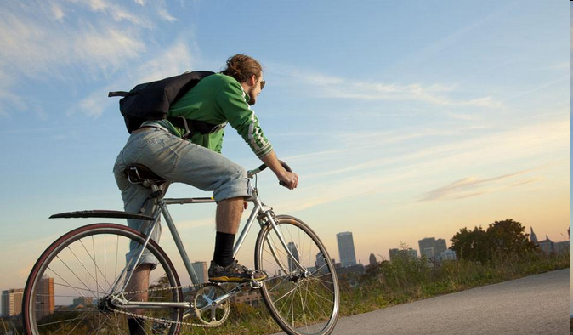
pollution n. 污染；污染物 (不可数名词)
air pollution 空气污染
noise pollution 噪声污染
pollute v. 污染
e.g. Bicycle is a good exercise. It doesn’t pollute the air.
自行车是一种好的运动，它不污染环境。

Slide 6
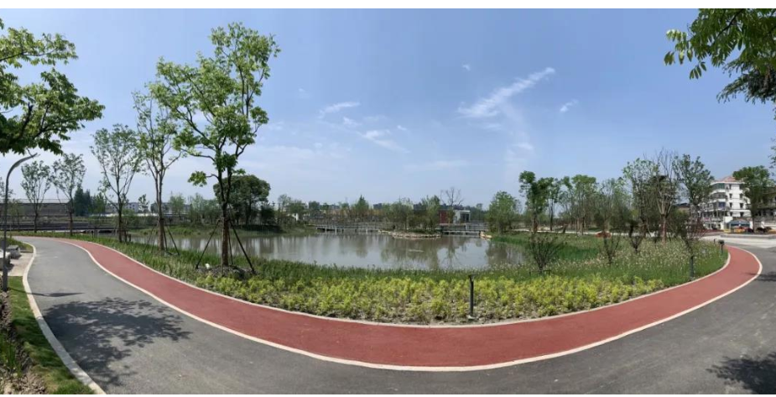
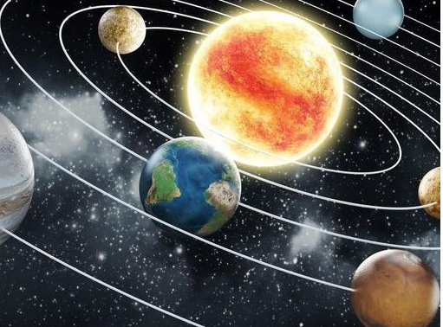
environment n. 环境
e.g. Our living environment is much better now.
现在我们的生活环境好多了。
planet n. 行星
earth n. 地球; 世界
e.g. The Earth is a planet and it goes around the Sun.
地球是一颗行星, 它绕着太阳转。

Slide 7
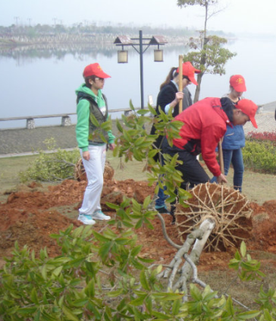
plant v. 种植 n. 植物
e.g. They want to plant trees around the
lake.
他们想在湖边种树。
part n. 部分
play a part in… 参与……; 在……中尽自己的一份力量
e.g. She plays an active part in teaching these children.
她积极参加对这些孩子的教学工作。

Slide 8


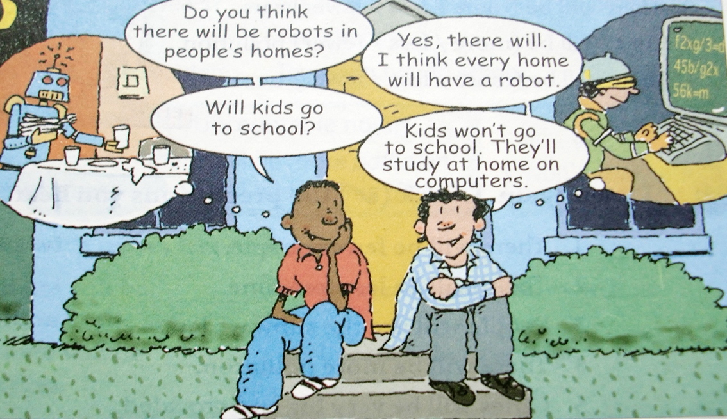
Where are the two boys?
What are they talking about?

Slide 9

Can you describe the two small pictures?
Do you think these situations (robot helping us at home; studying math on computer) are happening now or will happen in the future?

Slide 10

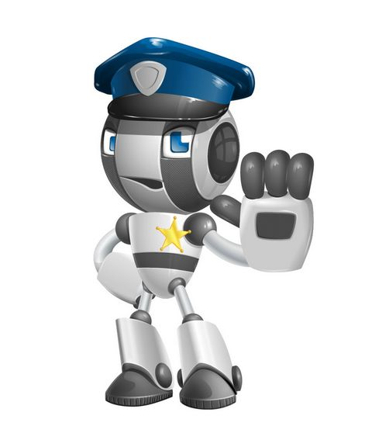

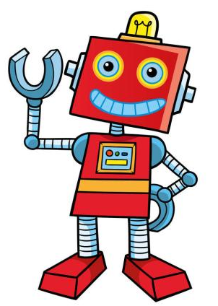


How will the world be different 100 years from now?
Will people have robots in their homes?

Slide 11
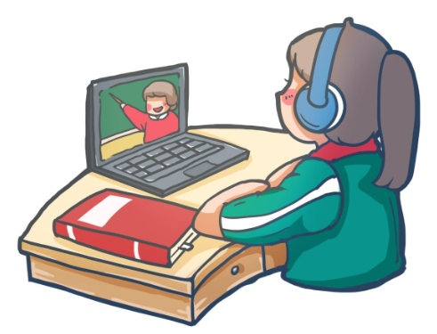
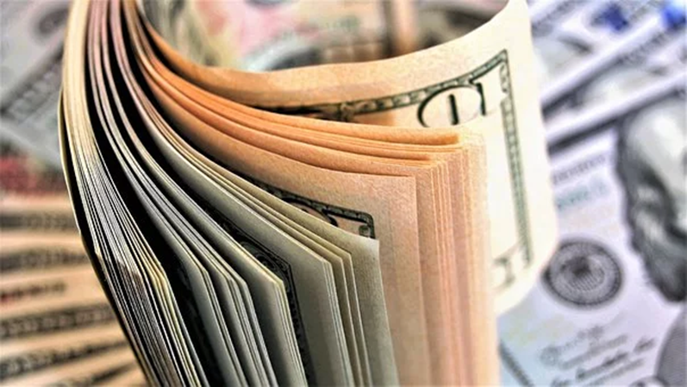
Will students only study on computers?
Will we use paper money?
n. 纸; 纸张

Slide 12
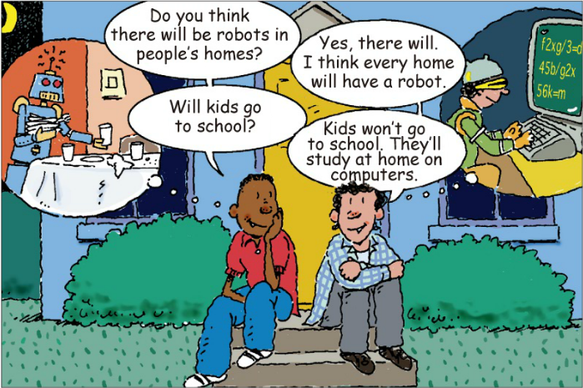
Look and learn to use “will …” to talk about or predict the future.
n. 将来; 未来
Kids will not go
They will
一般将来时对未来进行预测

Slide 13

Do you think these predictions will come true?
What other predictions about the future can you make?
n. 预言; 预测

Slide 14



How will the world be different from now in 100 years? Read these predictions.
Check (√) A for agree or D for disagree.

Slide 15
A D 1. People will have robots in their homes.
A D 2. People won’t use money. Everything will be free.
A D 3. Books will only be on computers, not on paper.
A D 4. Kids won’t go to school. They’ll study at home on computers.
A D 5. There will be only one country.
A D 6. People will live to be 200 years old.
live to (be) + 年龄：活到……岁

Slide 16

No, they won’t. They’ll study at home on computers.
Will kids go to school?
I hope so.
Will there be only one country?

Slide 17


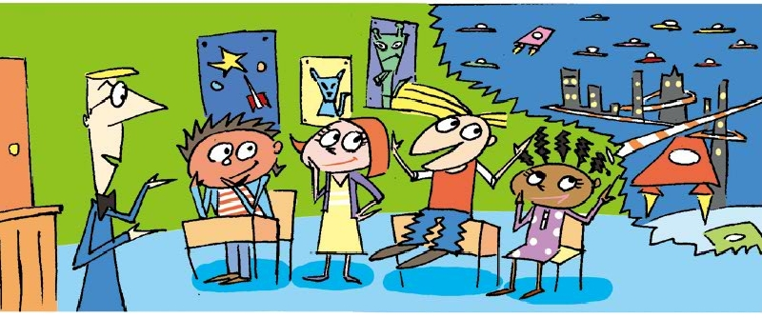
How many people are there in the picture?
What are they talking about?
There are five people in the picture: one teacher, two boy students, and two girl students. There is a city and probably some planets and two spaceships in the thought bubble. There are some pictures of robots and a spaceship on the classroom wall.

Slide 18
There be结构在一般将来时中的运用:
There will be + more/less/fewer + 名词
more (many和much的比较级) + 可数名词或不可数名词
less (little的比较级) + 不可数名词
fewer (few的比较级) + 可数名词
more, less和fewer 都表示同类事物之间的比较。
e.g. There will be more people.

Slide 19


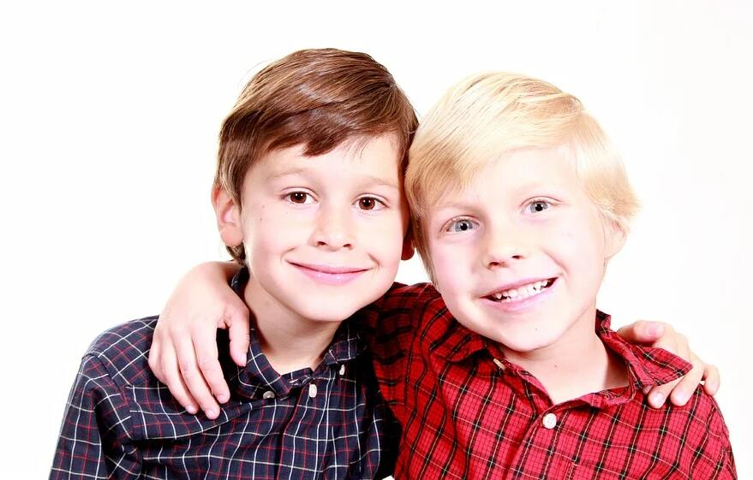
Make conversations about the predictions in 2a and 2b.
What’s your prediction about the future?
I think there will be more pollution.
Really? I don’t think so. But I think there will be fewer trees.

Slide 20
句式: 主语+will(’ll) + 动词原形...
表示将来某个时间要发生的动作或存在的状态
否定句式:
主语+will not(won’t) + 动词原形...
一般疑问句式:
Will + 主语 + 动词原形...？
特殊疑问句式:
特殊疑问词+will+主语+ 动词原形...

Slide 21
Unit 7
Will people have robots?
Predictions about the Future
n. 预言；预测

Slide 23
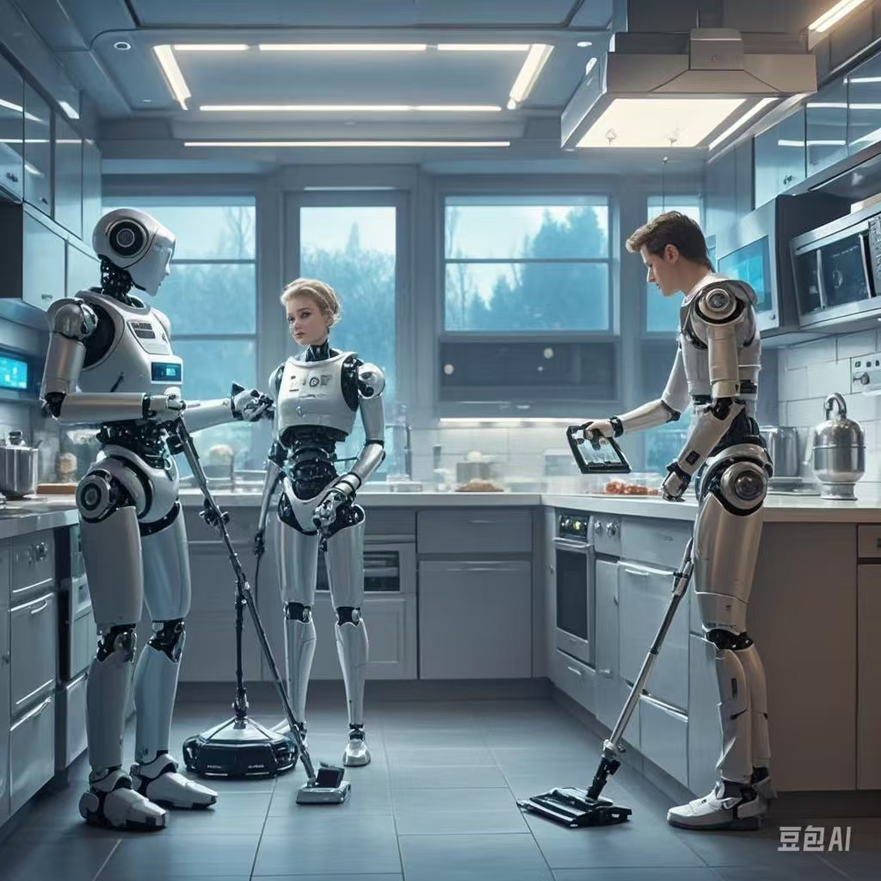
Unit 7
Will people have robots?
Predictions About the Future
n. 预言;预测
n. 将来；未来

Slide 24
Free Talk: What’s your prediction about the future?
——What will the future be like?
——...will...
...won’t(will not)...
There will be...
There won’t be...

Slide 25
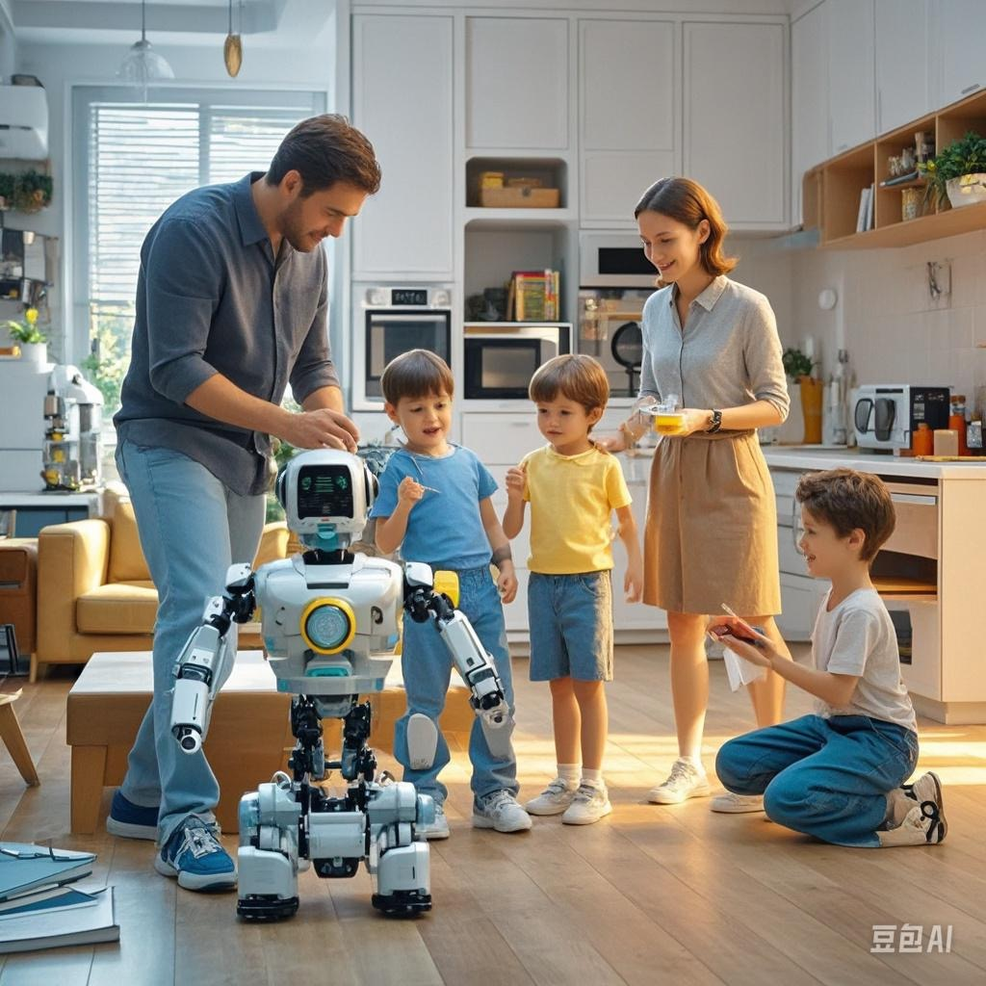
Predictions About the Future
——What will the future be like?
——There will be a robot in
anyone’s home.

Slide 26
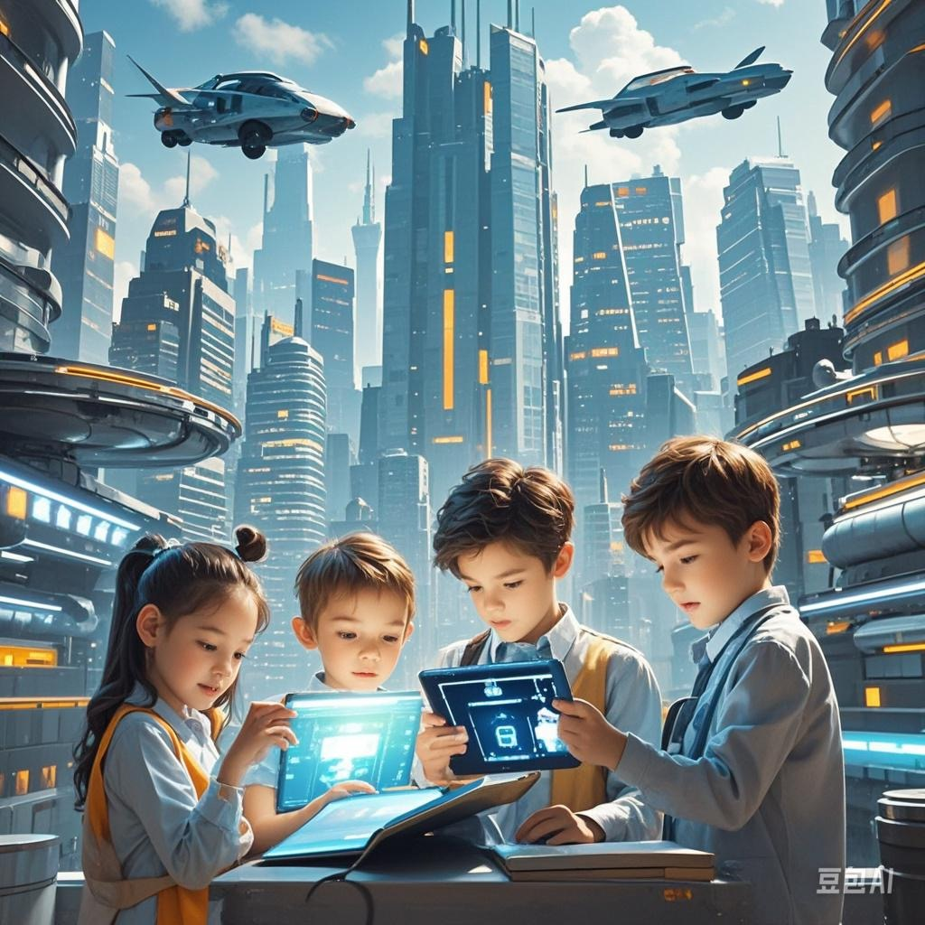
Predictions About the Future
—What will the future be like?
—Children will read books on computers but not on paper./
Books will be on computers, not on paper.
un. 纸

Slide 27
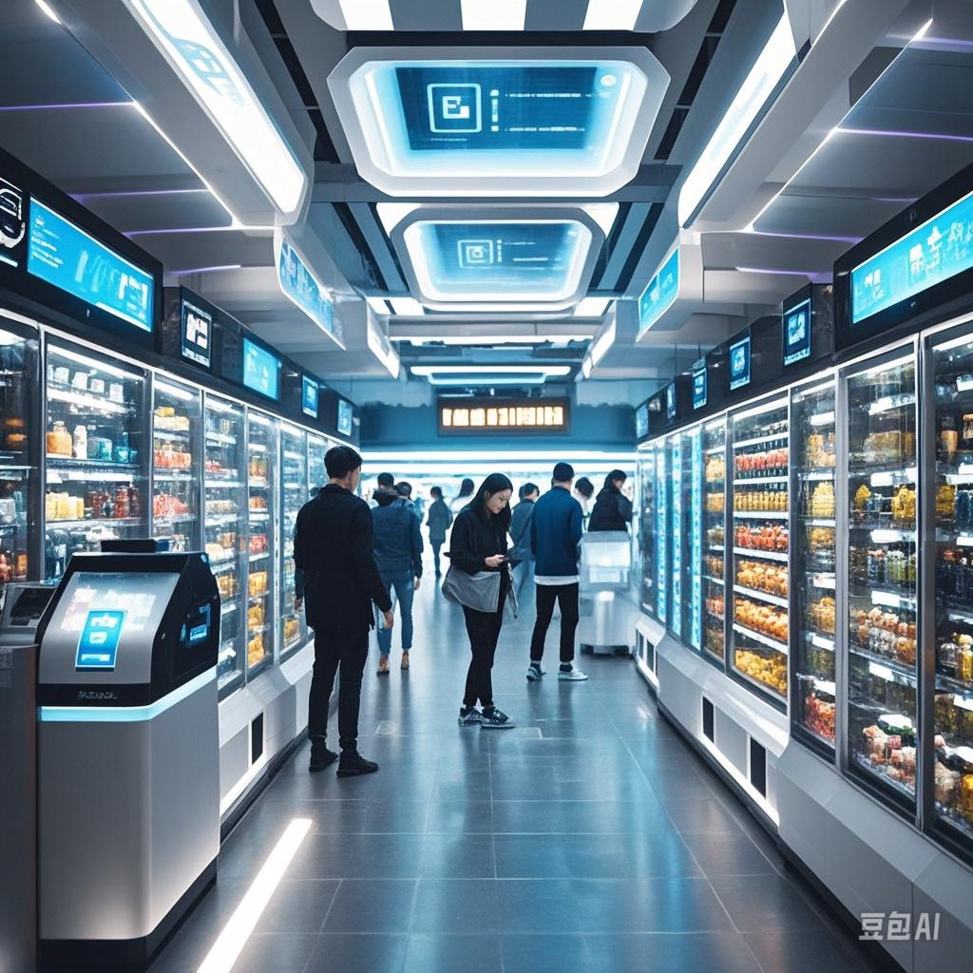
Predictions About the Future
——Will people need to use money or pay when they shop in 100 years?
——No, people won’t use money.
Everything will be free.

Slide 28
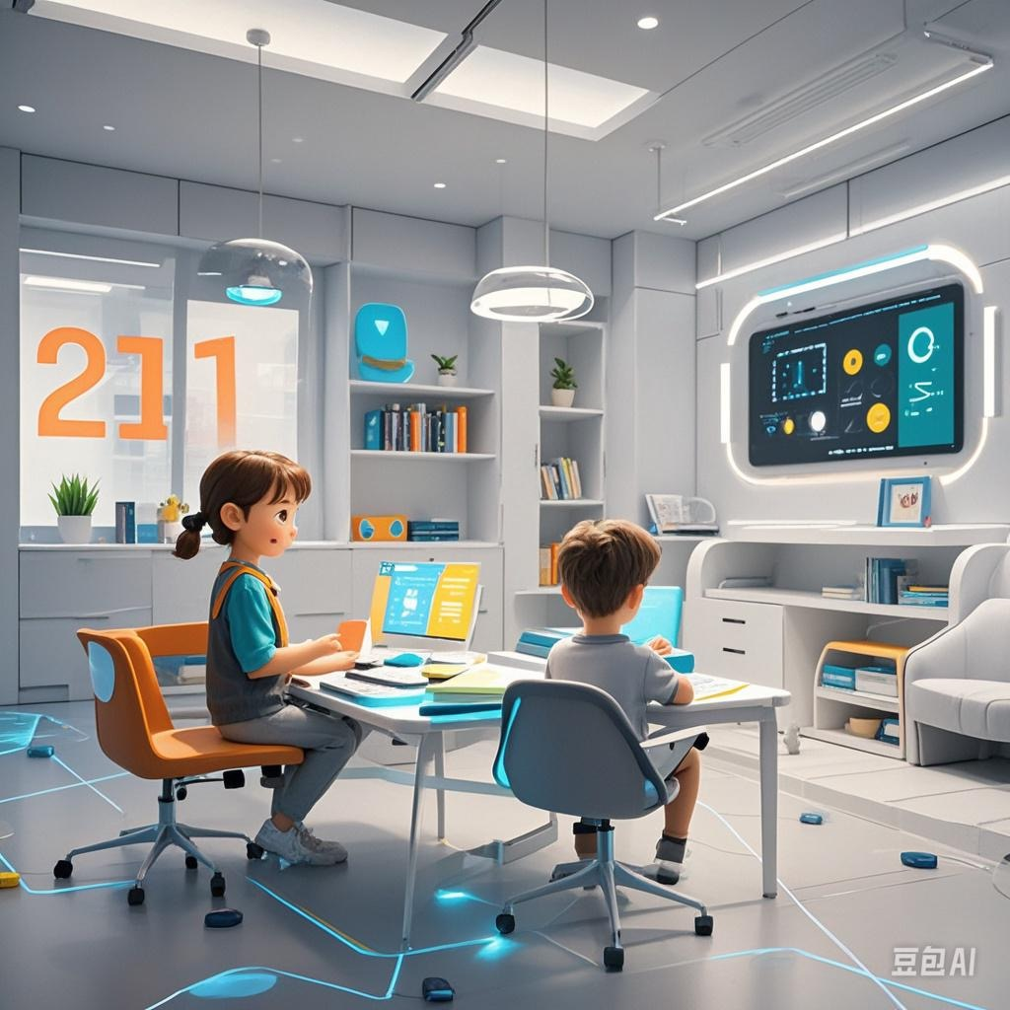
Predictions About the Future
—Will kids go to school and study there in the future?
—No, kids won’t go to school.
They’ll study at home on computers.

Slide 29
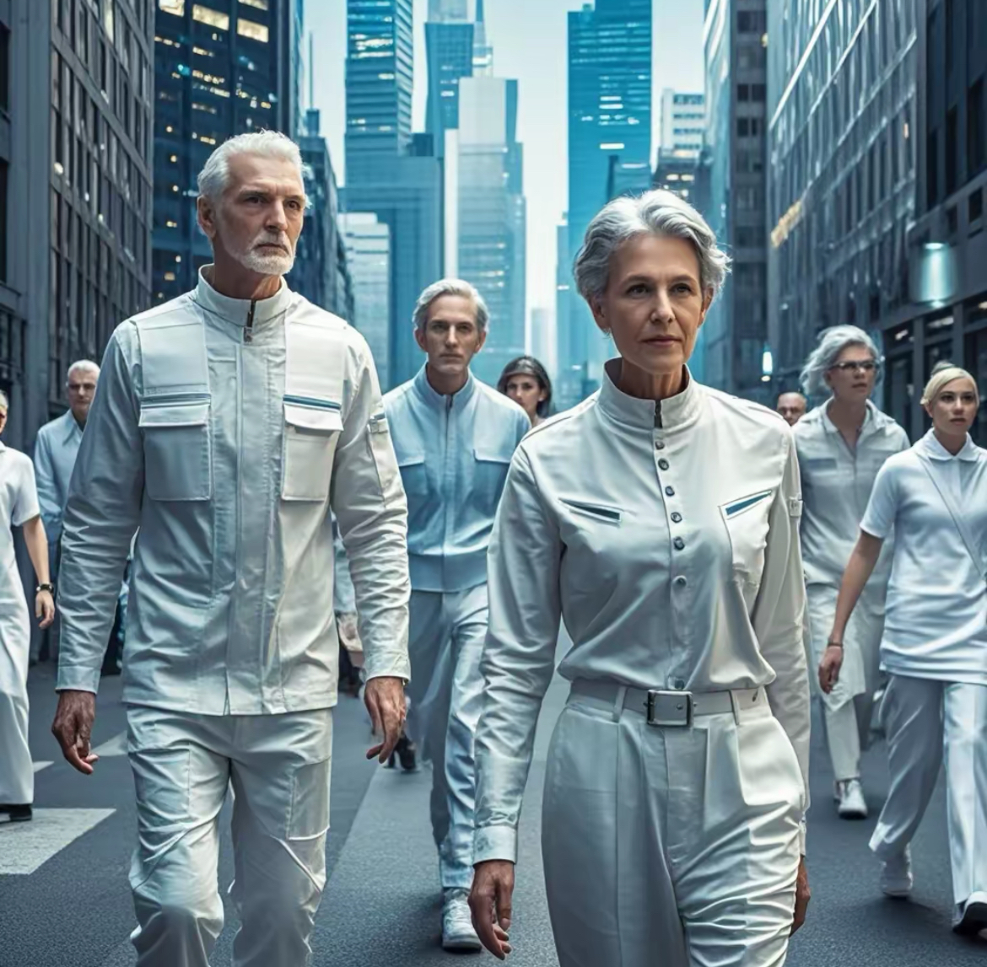
Predictions About the Future
—Will people live to be 200 years old?
—Yes, they will./
No, they won’t.

Slide 30
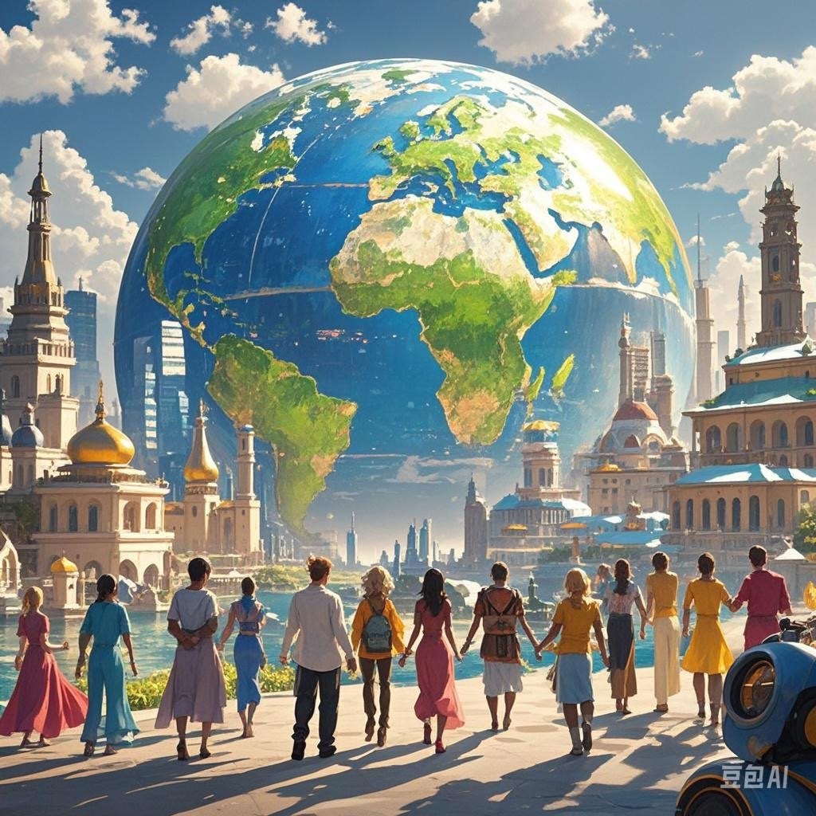
Predictions About the Future
—Will there be only one country in the world?
—Yes, there will./
No, there won’t.

Slide 31
How will the world in 100 years be different from now?
Read these predictions.
Check (√) A for agree or D for disagree.
v. 同意 v.不同意
A D 1. People will have robots in their homes.
A D 2. People won’t use money.
Everything will be free.
A D 3. Books will only be on computers, not on paper.
A D 4. Kids won’t go to school.
They’ll study at home on computers.
A D 5. There will be only one country (in the world).
A D 6. People will live to be 200 years old.
un. 纸

Slide 32



Ask and answer questions about predictions in 1a.
No, they won’t. Everything will be free.
Will people use money in 100 years?
Yes, they will.
/Yeah, probably.
Will people live to be 200 years old?
adv. 很可能；大概

Slide 33
—— Will people ... in 100 years?
——Yes, they will. / No, they won’t.
Agree Disagree 1. People will have robots in their homes.
A D 2. People won’t use money.
Everything will be free.
A D 3. Books will only be on computers, not on paper.
A D 4. Kids won’t go to school.
They’ll study at home on computers.
A D 5. There will be only one country (in the world).
A D 6. People will live to be 200 years old.
—— Will there be ... in 100 years?
——Yes, there will. / No, there won’t...

Slide 34



Listen and circle the predictions you hear in 1a.
1. People will have robots in their homes.
2. People won’t use money. Everything will be free.
3. Books will only be on computers, not on paper.
4. Kids won’t go to school. They’ll study at home on computers.
5. There will be only one country.
6. People will live to be 200 years old.

Slide 35
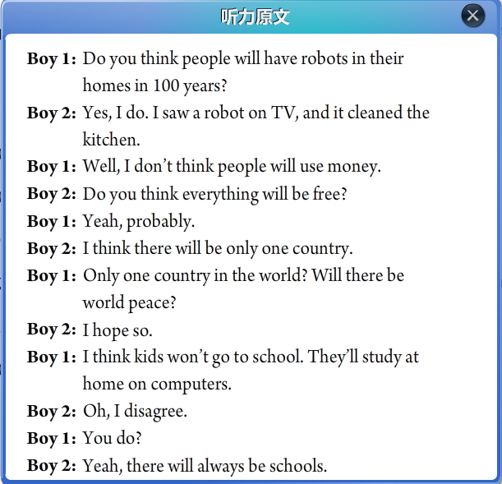


Slide 36

I hope so.
此句意为Yes, I hope there will be world peace.
so为副词，代替上文所说内容，使得语句简练。
除hope之外，so还常与think(想)，believe(相信)，guess(猜测)等搭配，在口语中很普遍。
e.g. A: Is he coming to see us?
B: I think so.

Slide 37
句式: will(’ll) + 动词原形
表示将来某个时间要发生的动作或存在的状态
否定句式:
will not(won’t) + 动词原形
一般疑问句式:
Will + 主语 + 其他？
特殊疑问句式:
特殊疑问词+will+主语+其他？

Slide 38

there be句型的一般将来时
肯定句： There will be ...
否定句： There won’t(will not) be ...
一般疑问句：Will there be ...?
Yes, there will. / No, there won’t.

Slide 39
Review 记笔记
more songs
更多的歌曲
原级 | 比较级 | 用法
many 许多
much 许多
few 很少
little 很少
more juice
更多的果汁
more 更多
+cn复数
+un
+cn复数
+un
more 更多
less news
更少的消息
fewer 更少
fewer students
更少的学生
less 更少

Slide 40
Review
there be句型的一般将来时
肯定句： There will be ...
否定句： There won’t(will not) be ...
一般疑问句：Will there be ...?
Yes, there will. / No, there won’t.
There will be more people.
e.g. 将会有更多的人口。_______________________
将不会有更少的树。 _______________________
将会有更多的污染吗？_________________________ 将会有更少的业余时间。________________________
There won’t be fewer tress.
Will there be more pollution?
There will be less free time.
pollution un. 污染

Slide 41
Fill with more, fewer or less to talk about your predition.
——What’s your prediction about the future?
——I think/don’t think there will be _____ people in the future.
_____ free time
_____ cars
_____ pollution
_____fresh water
_____ trees
_____ jobs for people

Slide 42

Let’s choose!
Fill in the blanks with more, less or fewer.
1. In the future, there will be ____ fresh water because there will be _____ pollution in the sea.
2. In 100 years, there will be ______ cars because there will be ______ people in the cities.
3. There will be ______ jobs for people because ______ robots will do the same jobs as people.
less
more
more
more
fewer
more

Slide 43
Let’s choose!
4. I think there will be ______ cities because people will build ______ buildings in the country.
5. In 50 years, people will have ______ free time because there will be ______ things to do.
more
more
more
fewer

Slide 44


Listen and circle the words you hear about the future predictions.
1. There will be (more / less / fewer) people.
2. There will be (more / less /fewer) free time.
3. There will be (more / less / fewer) cars.
4. There will be (more / less / fewer) pollution.
5. There will be (more / less / fewer) trees.

Slide 45



Listen again. Check (√) the predictions you hear.
____ 1. There will be fewer people.
____ 2. There will be less free time.
____ 3. People will use the subways less.
____ 4. There will be more pollution.
____ 5. Cities will be very big and crowded.

Slide 46
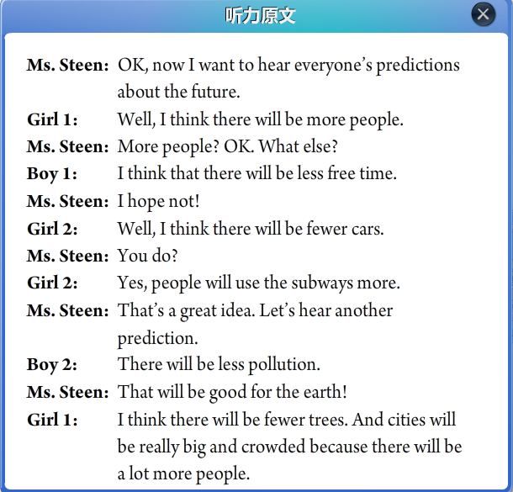

Slide 47



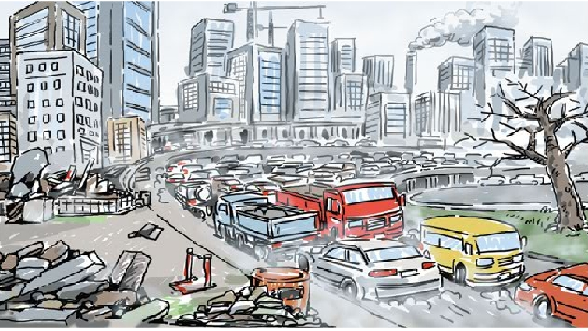
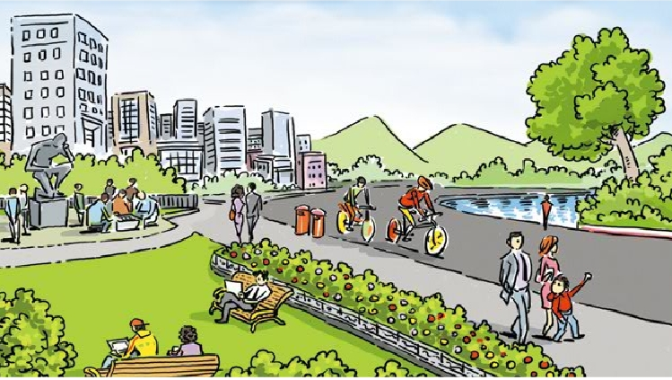
Let’s read!
Listen to the conversation first, read and answer the questions.
——What will the future be like in Jill’s book?
——Cities will be ______ ______ and ______.
There will be ______ ______.
The environment will be ______ ______ ______.
——If we want to live on the earth, what can we do?
——We can ______ ______ ______
and ______ ______ ______.
Everyone should play a part in ______ ______ ______.
more crowded polluted
fewer trees
in great danger
use less water
plant more trees
saving the earth
Jill is reading a
book about the future.

Slide 48
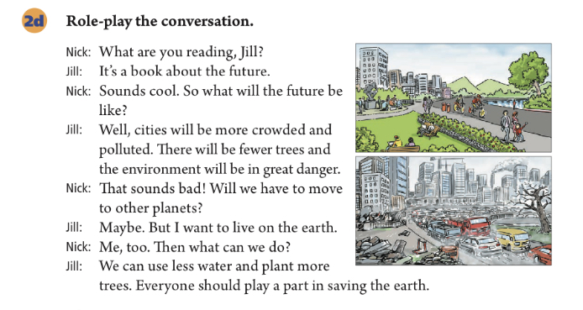

Slide 49

活到……岁
一百年以后
更少的树木
处于极大危险之中
搬到；搬迁
在地球上
种更多的树
拯救地球
live to be ... years old
in 100 years
fewer trees
be in great danger
move to
on the earth
plant more trees
save the earth

Slide 51
Fill in the blanks with more, less or fewer.
1. In the future, there will be ____ fresh water because there will be _____ pollution in the sea.
2. In 100 years, there will be ______ cars because there will be ______ people in the cities.
3. There will be ______ jobs for people because ______ robots will do the same jobs as people.
less
more
more
more
fewer
more

Slide 52
4. I think there will be ______ cities because people will build ______ buildings in the country.
5. In 50 years, people will have ______ free time because there will be ______ things to do.
more
more
more
fewer

Slide 53
Listen and circle the words you hear.
1. There will be (more / less / fewer) people.
2. There will be (more / less /fewer) free time.
3. There will be (more / less / fewer) cars.
4. There will be (more / less / fewer) pollution.
5. There will be (more / less / fewer) trees.

Slide 54
Listen again. Check (√) the predictions you hear.
____ 1. There will be fewer people.
____ 2. There will be less free time.
____ 3. People will use the subways less.
____ 4. There will be more pollution.
____ 5. Cities will be very big and crowded.

Slide 56
Listen to the conversation and answer the questions.
——What will the future be like in Jill’s book?
——Cities will be ______ ______ and ______.
There will be ______ ______.
The environment will be ______ ______ ______.
——If we want to live on the earth, what can we do?
——We can ______ ______ ______
and ______ ______ ______.
Everyone should play a part in ______ ______ ______.
more crowded polluted
fewer trees
in great danger
use less water
plant more trees
saving the earth
Jill’s reading a
book about future.

Slide 58
活到……岁
一百年以后
更少的树木
处于极大危险之中
搬到；搬迁
在地球上
种更多的树
拯救地球
live to be ... years old
in 100 years
fewer trees
be in great danger
move to
on the earth
plant more trees
save the earth

Slide 61
Listen to the conversation and answer the questions. You can read it if necessary.
1. What will the future be like according to the book about the future?
Cities will be more crowded and polluted.
There will be fewer trees and the environment will be in great danger.
Maybe people will have to move to other planets.

Slide 62
2. What can people do to save the earth?
We can use less water and plant more trees.
We should all play a part in saving the earth.
Role-play the conversation.

Slide 63
1. Do you think there will be robots in people’s homes?
你认为人们家里将会有机器人吗？
1) 含有宾语从句的主从复合句
本句是一个含有宾语从句的主从复合句，do you think 是主句，there will be…是宾语从句。如果do you think 放在句中，则为插入语，常放在疑问词之后，结构为：疑问词+ do you think + (主语+)谓语+其他成分？
e.g. Do you think it’s necessary to discuss our plan?
Which do you think is the best restaurant?

Slide 64
2) there will be… 将有……；会有……
是there be结构(存现句)的一般将来时，可以与“There is / are going to be …”进行句式转换。
e.g. There will be a film this afternoon.
=There is going to be a film this afternoon.
there be结构(存现句)中的主谓一致遵循“就近”原则，即be动词和最靠近它的名词在数上保持一致。
e.g. There is an umbrella and two magazines on the table.
There are two magazines and an umbrella on the table.

Slide 65
【语境应用】单项选择。
In the near future, there __________ self-driving cars in our city.
A. is B. was C. are D. will be
D

Slide 66
2. Will people use money in 100 years?
100年以后人们还会使用钱吗？
in 100 years 在100年以后
in为介词，其后跟一段时间：在……之后，通常用于一般将来时。
e.g. I’ll have some breakfast ready in a few minutes.

Slide 67
in + 时间段 | 表示以现在为起点的将来某一段时间之后，通常用于一般将来时 | 用how soon提问
after+ 时间段 | 表示以过去时间为起点的一段时间以后，通常用于一般过去时 | 用when提问
e.g. —How soon will your mother finish cooking dinner?
—In an hour.
—When did he receive her letter?
—After five weeks.

Slide 68
【语境应用】单项选择。
—Shall we stop and wait for others?
—Sounds good. I think they will catch up(赶上) ________ a few minutes.
A. during B. after C. for D. in
D

Slide 69
3. What’s your prediction about the future?
你对未来有什么预测？
future n. 将来；未来
in the future (在)将来；(在)未来
e.g. This may not happen in the future.
in future = from now on 今后；从现在起
e.g. I asked her to be more careful in future.

Slide 70
Ⅰ. 根据句意及所给首字母提示，补全所缺单词。
1. Water is important to all living things on the e , so we should save water.
2. Riding a bike is good for health. It can also help reduce (减少) air p .
3. I need some p and a pen to write a letter (信).
4. Nobody knows what will happen in the f .
5. Each child wants to have a happy home e .
earth
pollution
paper
future
environment

Slide 71
Ⅱ. 根据汉语意思，完成英语句子，每空一词。
1. 你将在这台手术中发挥重要作用。
You will ________ ________ ________ ________ ________ this operation.
2. 我希望50年后世界和平。
I hope there will be world peace _______ _______ _______.
3. 她的爷爷奶奶都活到了九十多岁。
Both her grandpa and grandma _______ _______ _______ _______ _______ years old.
play an important part/role in
in 50/fifty years
lived to be
over 90/ninety

Slide 72
4. John开车如此快以至于我感到有生命危险。
John drove so fast that I felt my life was _______ _______.
5. 他们卖掉了房子，搬到了一个小点儿的房子。
They sold their house and _______ _______ a smaller one.
in danger
moved to

Slide 73
写出几个对未来的预测，越多越好！
I think … in 100 years.
cars
people
future
trees
pollution
robots

